Slide 1






FEDEX CUSTOMER VOICE ANALYSIS
Under the Guidance of Dr. Nargis Pervin
RESEARCH TEAM
Aditi Deo Singh
Alan Alex Mathew
Bhavya Dhingra
Utsav Bhardwaj

Slide 2
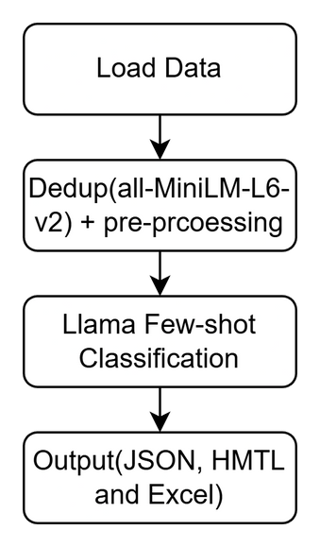
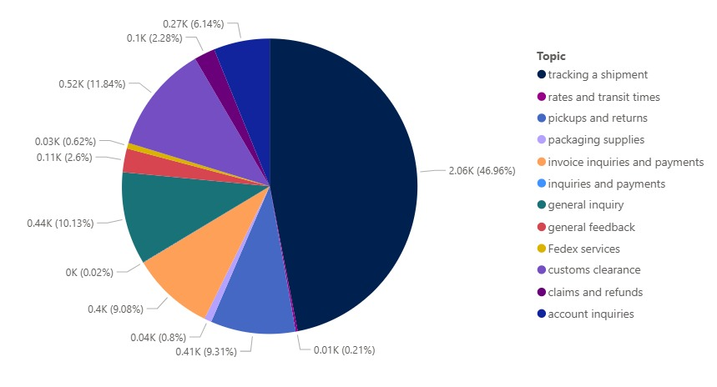
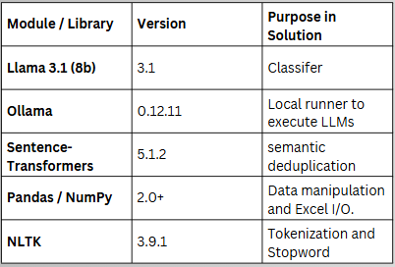
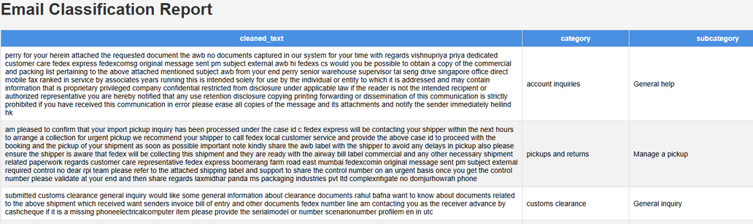
Topic Modeling
Flow-Diagram
Open Source Modules & Dependencies
Output
*Created using PowerBI
Results
The model has managed to achieve an accuracy of ~64% when compared with the ground truth labeling done by the research team.
*The accuracy might vary due to llama sometimes not sticking to the original 12 topics(taken from the FedEx website) and giving its own topics
Limitations
  Preprocessing wiping out contextual meaning(which is needed due to strong noise)
  Llama giving out self-labels(reduces the overall accuracy)
  Few-shot examples are currently abit vague, which limits precision for complex intents.

